Slide 1
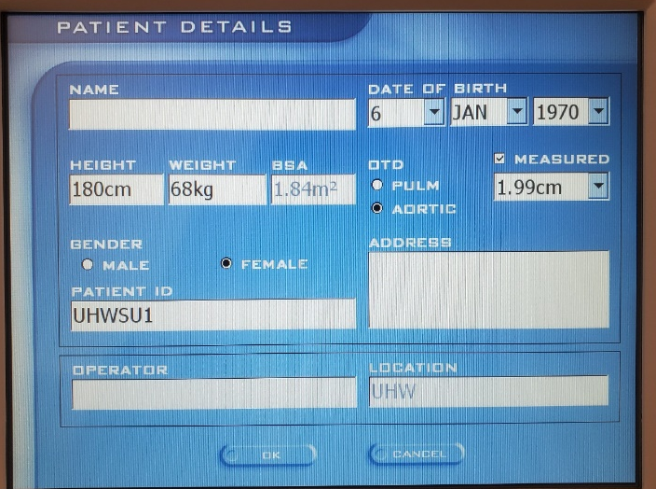
New Patient
Welcome Screen
Click ‘New Patient’
Enter
ID (incl. site code)
DOB
Height
Weight
Gender
(No identifiable data to be entered onto Uscom)
Uscom will calculate
Body Surface Area (BSA)
Valve area (aortic & pulmonary)
Leave OTD as ‘aortic’.
Click ‘OK’ to start an Examination

Slide 2
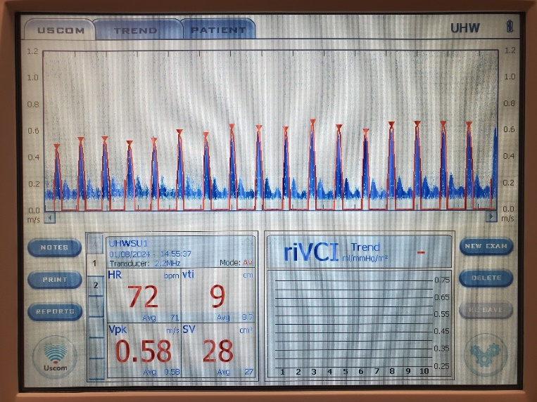
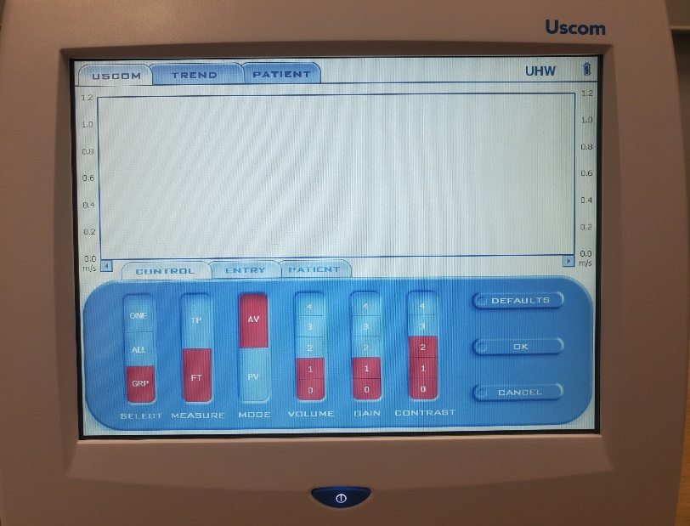
New Examination
Welcome Screen
‘OPEN’
Select participant ID, ‘OK’
‘NEW’
‘OK’
TREND tab should be blank
Ensure Trend shows riVCI
Ensure CONTROLS (cog symbols) are:
SELECT = GRP
MEASURE = FT
MODE = AV (unless measuring at the pulmonary valve)

Slide 3
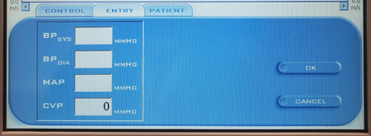
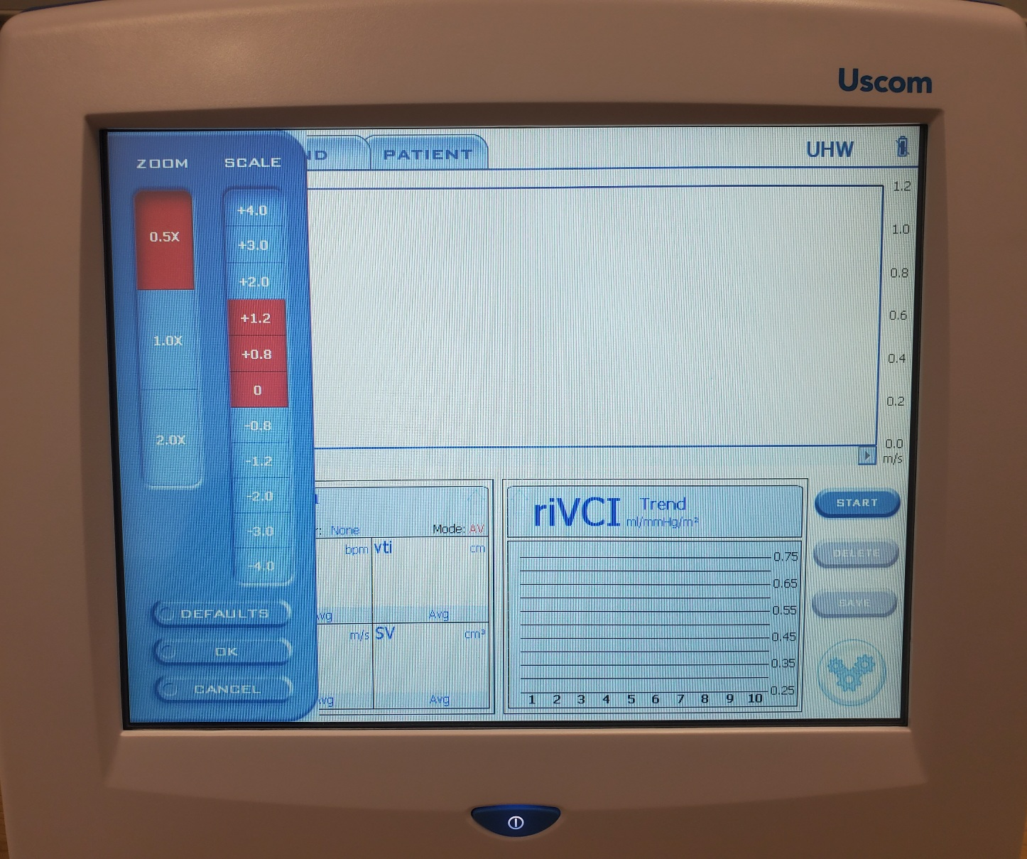
Go to ENTRY to enter SBP and DBP. Do this for each new Examination.
START to begin scanning
TRACE to stop the FlowTrace outline during the measurement
Click on a vertical axis to bring up the scale settings
Set ZOOM and SCALE as required to get a good signal.
Each Examination is 3 Measure Cards. Paced & unpaced recordings are separate Examinations.
START to begin scanning
FREEZE to stop and store 20s of data
Ensure ZOOM is set back to 0.5
Scroll horizontally to show best set of complete heart beats with red outlines
SAVE to create a new Measure Card
Do this 3 times.
Enter the Exam Time on CRF.
Add an Uscom NOTE to identify whether this Examination is paced or unpaced.

